Slide 1
The Movies Dataset Project Ahmed Al-dayel Data Visualization

Slide 2
To download the data set:
https://www.kaggle.com/rounakbanik/the-movies-dataset

Slide 3

The Problem Statement:
Why production companies revenue has not been greater than 245 Billion in the last 10 years?

Slide 4

Executive summary
Elements that impact on the revenue:
- Viewers Popularity
- Release time.
- Budget particularly marketing and advertising.
Based on my analysis, My recommendations are:
-Showing the movies on the main page and publish trailer on social media.
-focus on popularity genres.
-Publish the movies in June.
-Raise and prepare the budget which will improve the revenue

Slide 5
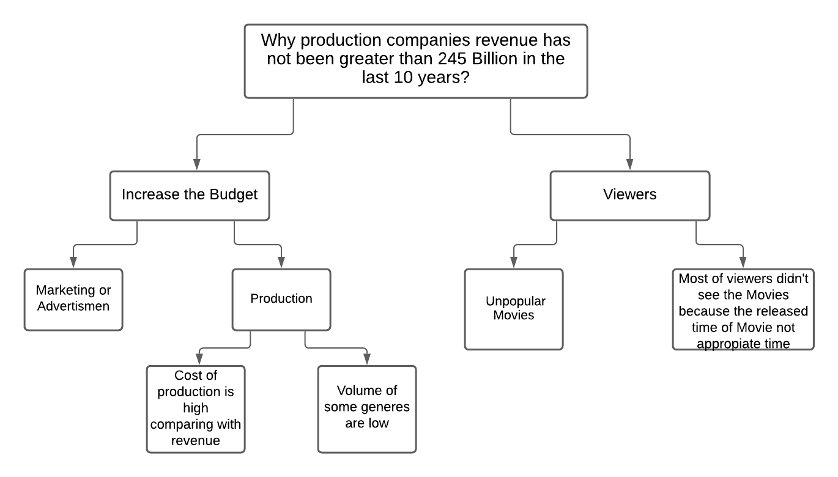
Issue Tree

Slide 6

Overview of Analysis
The problem statement was to determine:
Why production companies revenue has not been greater than 245 Billion in the last 10 years?
My analysis focused into three workstreams:
1- If the budget affects revenue.
2- If popularity genres affect on revenue.
3- If release time affects revenue.

Slide 7
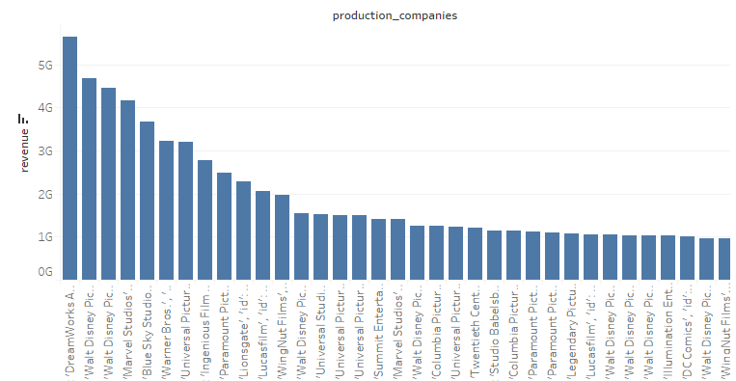
Revenue Of Production company Last 10 year
You can see from the chart above the revenue of production companies

Slide 8
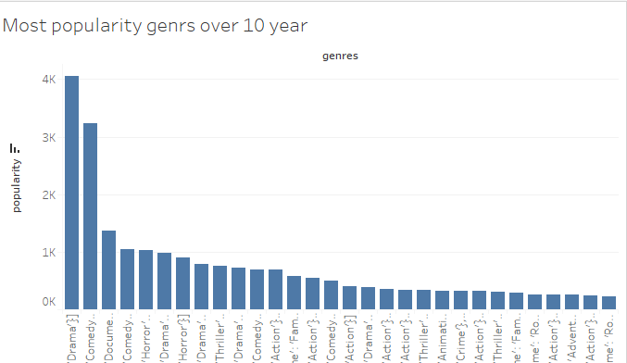
Most popularity genres over 10 year
You can see from the chart above the most popular genres is Drama, so you must choose the appropriate genres in future production to increase the revenue.

Slide 9
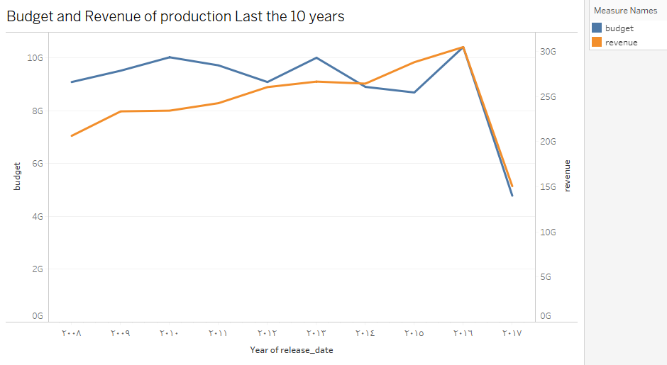
Budget and Revenue of production last the 10 years
You can see from the chart above the revenue and budget and the budget is higher than revenue so you must prepare for the budget to be appropriate with revenue.

Slide 10
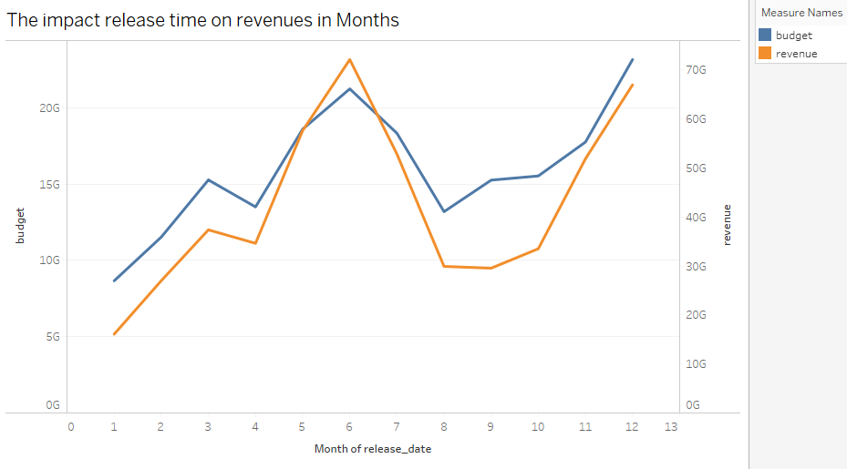
The impact release time on revenues in Month
You can see from the chart above the high revenue is in June so the best time to publish the movies is in June.

Slide 11
Biases and Limitations
Data Collection:
-The budget is not detailed enough.
-Not knowing how popularity has been calculated.
-The evaluation were only from those who visited the IMDB website.
-Most of data are collected from US so you can’t get accurate information.

Slide 12
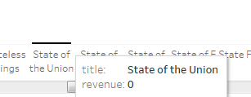
Biases and Limitations
Data processing:
The distribution of most elements are skewed with outliers because of the missingness values in revenue and budget variables for most of the movies which affect the recommendation. I chose to include it in certain analyzes while removing it from revenue and budget analysis. So that I could compare it with other genres.

Slide 13
Conclusion
We have seen above that the popularity genres will affect on the revenue so we should choose the popularity genres in our future productions, also the released time of movies will affect on the revenue so we should choose the appropriate time to release our future movies and also should determine or prepare for the budget of the movie to be appropriate with movies revenue.

Slide 14

My Story Link:
https://public.tableau.com/profile/ahmed.aldayel#!/vizhome/MovieDashboard_16036204826770/Story1?publish=yes

